Slide 1

DAYANANDA SAGAR COLLEGE OF ENGINEERING,
SHAVIGE MALLESHWARA HILLS, K.S. LAYOUT, BANGALORE -560078.
DEPARTMENT OF COMPUTER SCIENCE AND ENGINEERING
Federated Learning and Homomorphic Encryption
1DS18CS101 RG Shruthii
1DS18CS105 Rohan Dinesh
1DS18CS106 Rohan S Jamadagni
1DS18CS129 Tishya Sohankumar Thakkar

Slide 2
Problems in Machine Learning
Machine learning models are difficult to share across various users
Current data privacy regulations such as the GDPR in Europe limits the use of AI solutions
it is almost impossible for rival companies to exchange data due to a lack of trust between them
This situation limits our abilities to innovate when more data is needed
Having a new encryption method would benefit many companies, create new ecosystems and business models.

Slide 3
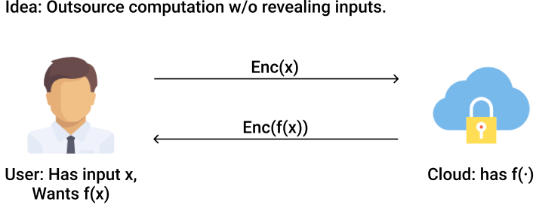
Homomorphic Encryption
Homomorphic Encryption allows computations to be performed directly on encrypted data by using advanced cryptology
For example, hospitals can send sensitive encrypted data to Data Scientists who can train and perform inference
Notes:
For sensitive data, homomorphic encryption can be used to enable new services by removing privacy barriers
Homomorphic Encryption removes the need for decrypting the data before you use it. In other words, data integrity and privacy are protected while you process data.

Slide 4
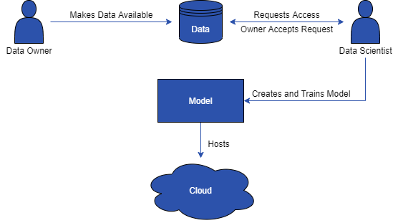
How does it work?

Slide 5
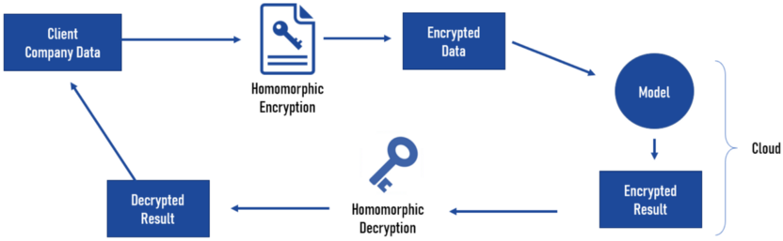
How does it work?

Slide 6
Demo

Slide 7
Future Enhancements
Build web frontend for both Data Owner and Data Scientist
Scale it for multiple clients using PyGrid

Slide 8
Thank You

